Slide 1
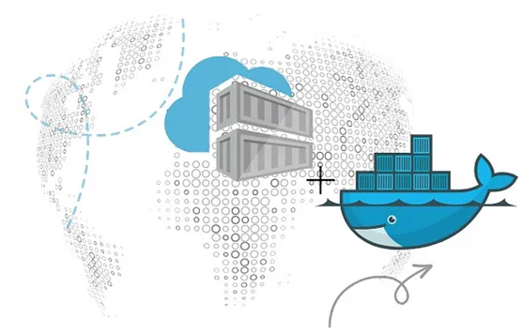
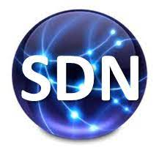
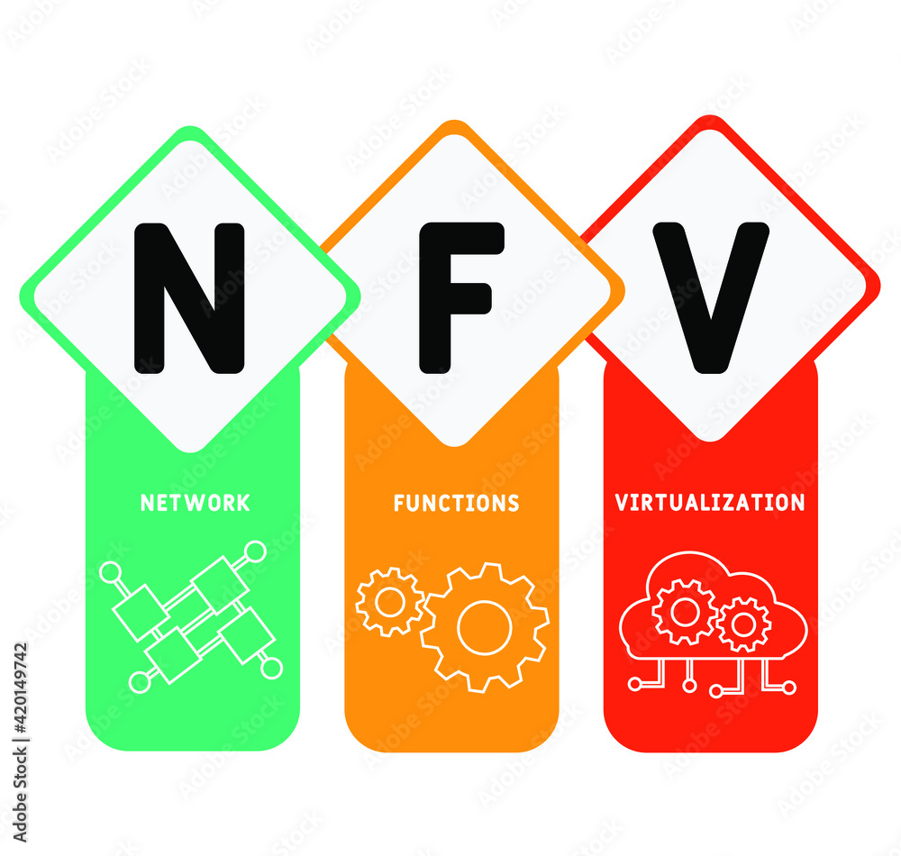
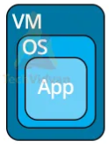
PDS
Computer Vision
Chapter 5
Global Trends in IoT (Internet of things)
Ecosystem and IoT architecture
https://github.com/siagianp
https://www.youtube.com/@AmelOline/videos
https://github.com/amelcharolinesgn2/IoT_simulator-mqtt-NodeRed
https://github.com/amelcharolinesgn2/Cloud-Infrastructures
https://github.com/amelcharolinesgn2/IoT_app-and-Modules
https://github.com/amelcharolinesgn2/ClouD-Infrastructure-SISKA-2025
Notes:
https://www.mi.fu-berlin.de/inf/groups/ag-tech/teaching/2012-13_WS/L_19528_Embedded_Internet_and_the_Internet_of_Things/08.pdf
https://www.hivemq.com/blog/mqtt-vs-coap-for-iot/

Slide 2
Content
Introduction
Benefits of IoT
Application and use of IoT
IoT challenges
What needs to be done?
Top IoT technologies and trends
Future of IoT

Slide 3
Introduction – what is IoT?
The Internet of things (IoT) is a system of interrelated computing devices, mechanical and digital machines, objects, animals or people that are provided with unique identifiers ( UIDs ) and the ability to transfer data over a network without requiring human-to-human or human-to-computer interaction - IoT Agenda
A thing in the IoT can be a person with a heart monitor implant, a farm animal with a biochip transponder, an automobile that has built-in sensors to alert the driver when tire pressure is low or any other natural or man-made object that can be assigned an IP address and is able to transfer data over a network.
IoT is a sensor network of billions of smart devices that connect people, systems and other applications to collect and share data.

Slide 4
Introduction – cont’d
IoT is a concept of connecting any device with an on and off switch to the Internet (and/or to each other). This includes everything from cellphones, coffee makers, washing machines, headphones, lamps, wearable devices and almost anything else you can think of. This also applies to components of machines, for example a jet engine of an airplane or the drill of an oil rig – Forbes.
The IoT is a giant network of connected "things" (which also includes people). The relationship will be between people-people, people-things, and things-things.
The dominant consumer IoT device, worldwide, is the smart TV. Between 25-35% cent of consumers worldwide own a television that can connect to the Internet, according to a Deloitte research. However, other areas of the IoT market are growing rapidly.

Slide 5
Why IOT?
Organizations in a variety of industries are using IoT to operate more efficiently, better understand customers to deliver enhanced customer service, improve decision-making and increase the value of the business.

Slide 6
IoT ecoystem
An IoT ecosystem consists of web-enabled smart devices that use embedded processors, sensors and communication hardware to collect, send and act on data they acquire from their environments.
IoT devices share the sensor data they collect by connecting to an IoT gateway or other edge device where data is either sent to the cloud to be analyzed or analyzed locally.

Slide 7
IoT Architecture
The IoT Ecosystem: Components,Architecture, CommunicationTechnologies, and Protocols
Notes:
https://www.researchgate.net/publication/364331685_The_IoT_Ecosystem_Components_Architecture_Communication_Technologies_and_Protocols

Slide 8
Top 10 Strategic IoT Technologies and Trends - GARTNER
Trend No. 1: Artificial Intelligence (AI): “Data is the fuel that powers the IoT and the organization’s ability to derive meaning from it will define their long term success.”
Trend No. 2: Social, Legal and Ethical IoT: These include ownership of data and the deductions made from it, algorithmic bias, privacy and compliance with regulations such as the General Data Protection Regulation. “Successful deployment of an IoT solution demands that it’s not just technically effective but also socially acceptable.”
Trend No. 3: Infonomics and Data Broking: The theory of infonomics takes monetization of data further by seeing it as a strategic business asset to be recorded in the company accounts. By 2023, the buying and selling of IoT data will become an essential part of many IoT systems.

Slide 9
Top 10 Strategic IoT Technologies and Trends – GARTNER (cont’d)
Trend No. 4: The Shift from Intelligent Edge to Intelligent Mesh: The shift from centralized and cloud to edge architectures is well under way in the IoT space. These mesh architectures will enable more flexible, intelligent and responsive IoT systems — although often at the cost of additional complexities.
Trend No. 5: IoT Governance: As the IoT continues to expand, the need for a governance framework that ensures appropriate behaviour in the creation, storage, use and deletion of information related to IoT projects will become increasingly important.
Trend No. 6: Sensor Innovation: The sensor market will evolve continuously through 2023. New sensors will enable a wider range of situations and events to be detected.

Slide 10
Top 10 Strategic IoT Technologies and Trends – GARTNER (cont’d)
Trend No. 7: Trusted Hardware and Operating System: ‘.. by 2023, we expect to see the deployment of hardware and software combinations that together create more trustworthy and secure IoT systems…’.
Trend 8: Novel IoT User Experiences: User experience driven by 4 factors: new sensors, new algorithms, new experience architectures and context, and socially aware experiences.
Trend No. 9: Silicon Chip Innovation: By 2023, it’s expected that new special-purpose chips will reduce the power consumption required to run IoT devices.
Trend No. 10: New Wireless Networking Technologies for IoT: IoT networking involves balancing a set of competing requirements. In particular they should explore 5G, the forthcoming generation of low earth orbit satellites, and backscatter networks.

Slide 11
Benefits of IoT
IoT offers a number of benefits to organizations, enabling them to:
Monitor their overall business processes;
Improve the customer experience;
Save time and money;
Enhance employee productivity;
Integrate and adapt business models;
Make better business decisions; and
Generate more revenue.

Slide 12
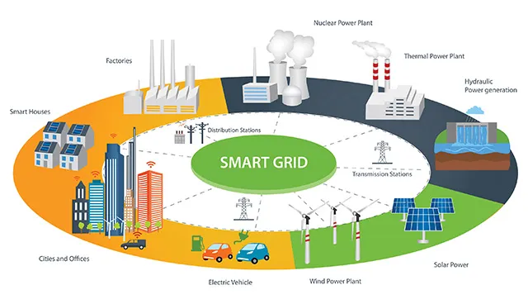
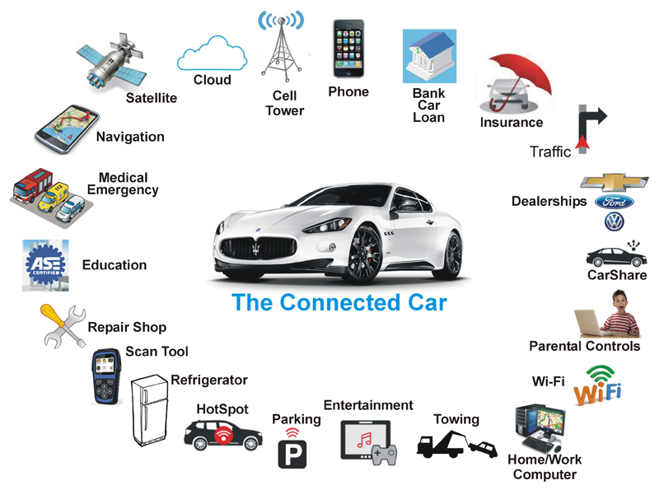
Consumer and enterprise IoT applications
What is a connected car and what are its benefits?

Slide 13
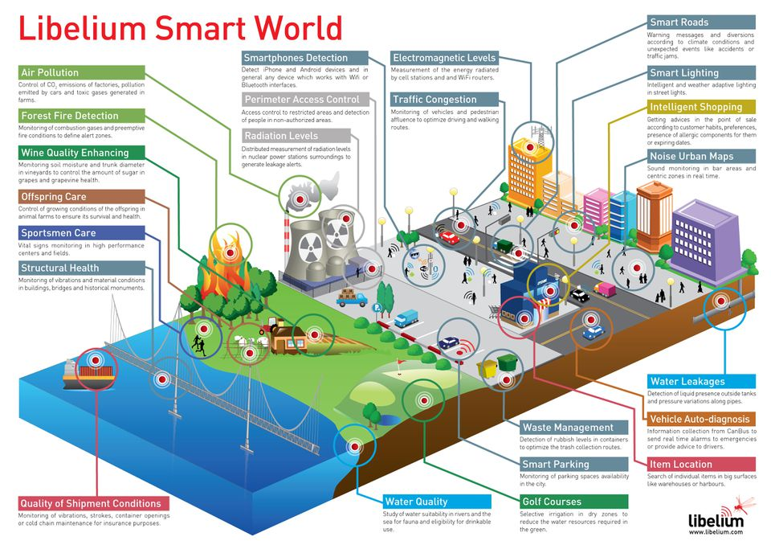
The smart world of the future – using Iot
Source: https://www.forbes.com/sites/jacobmorgan/2014/05/13/simple-explanation-internet-things-that-anyone-can-understand/#ef2433f1d091
Notes:
Common IoT Protocols - November 2019 Webinar

Slide 14
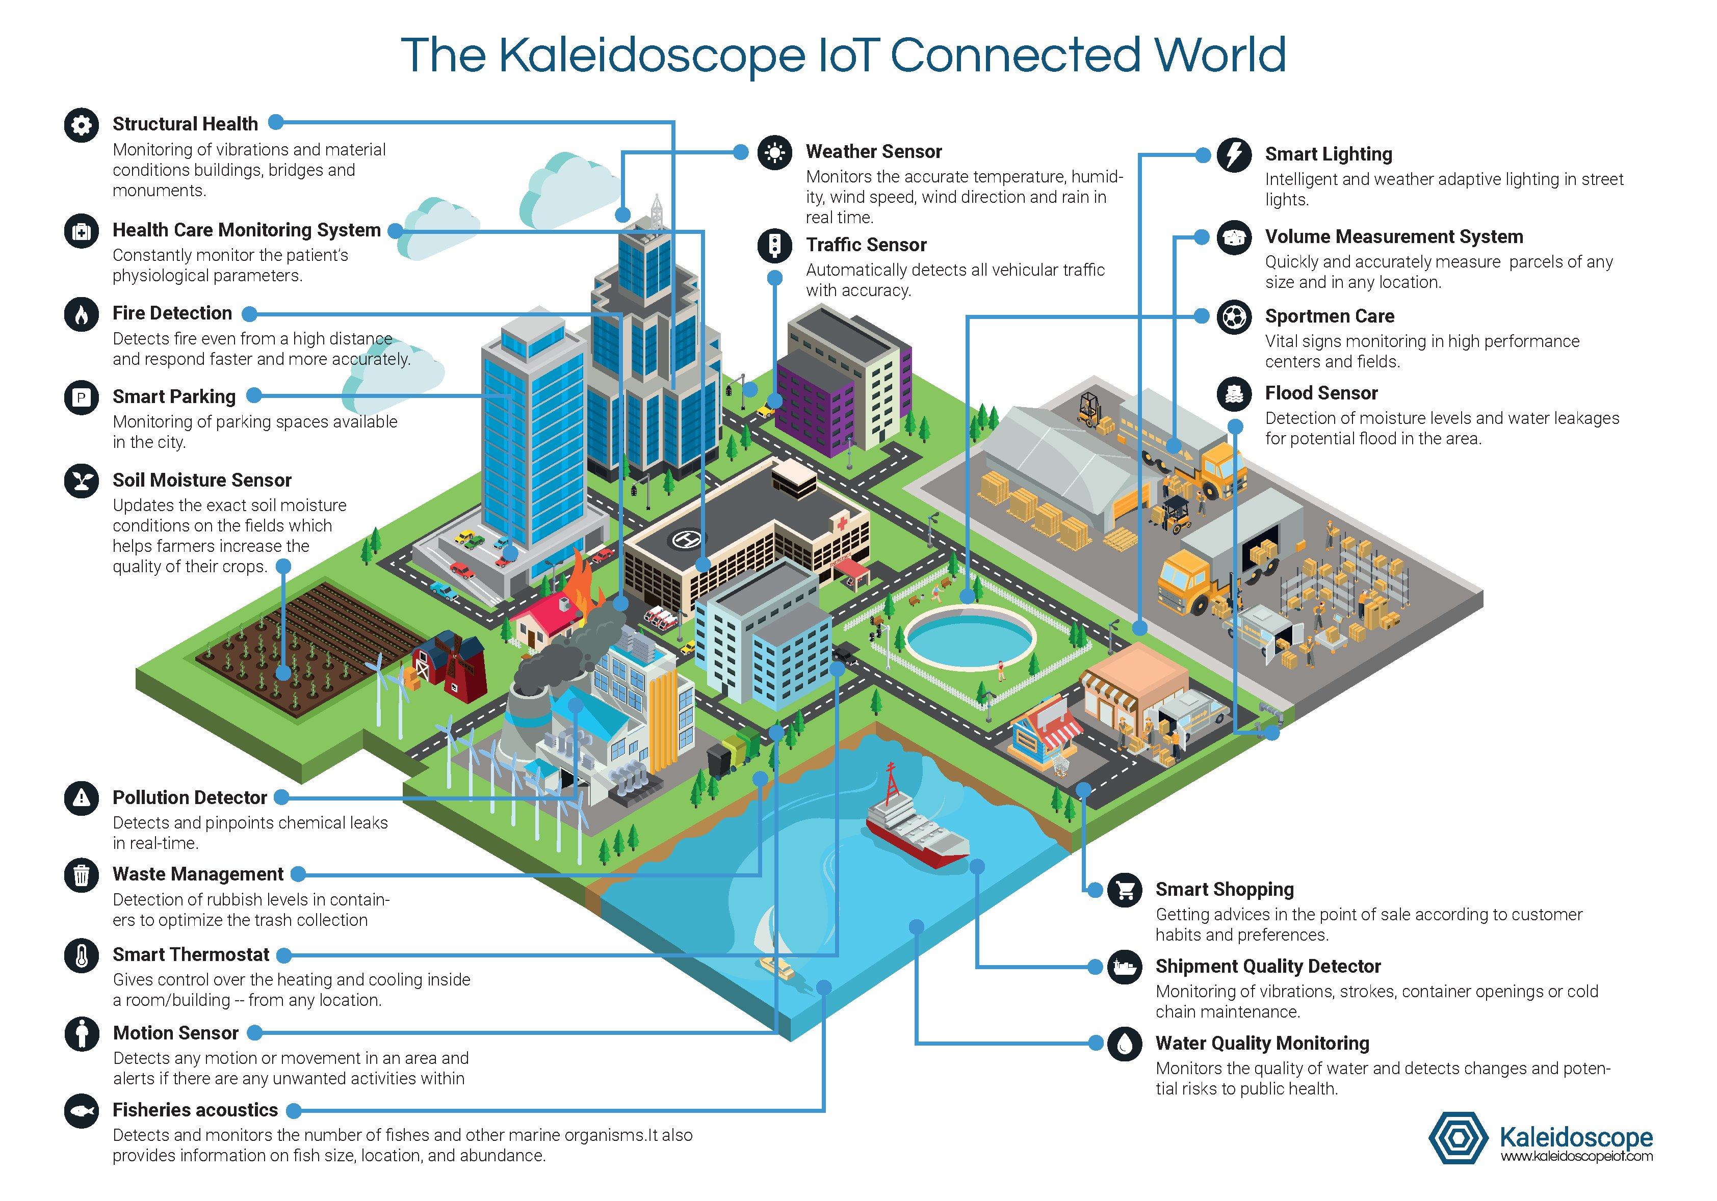

Slide 15
Sample: consumer iot products & Services
Helmet Concussion Sensor
Medical Alert Watch
Smart Fitness Clothing and Smart Running Shoes
Smart Televisions

Slide 16
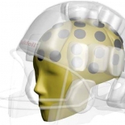
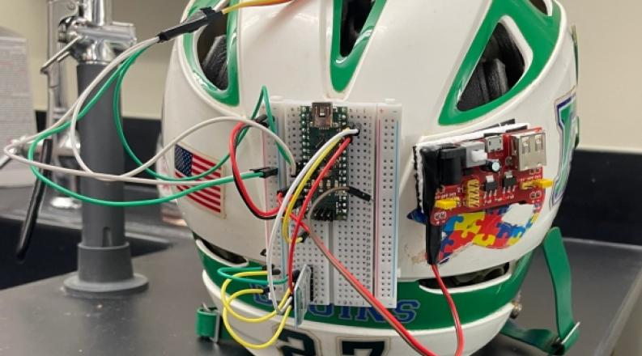
Smart Textile Impact Sensor for e-Helmet to Measure Head Injury
Source:
https://www.odu.edu/article/odu-engineering-students-develop-affordable-concussion-detection-device-for-youth-sports
https://www.mdpi.com/1424-8220/24/9/2919
https://www.tekscan.com/applications/flexiforce-sensors-aid-in-concussion-detection-research

Slide 17
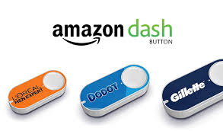
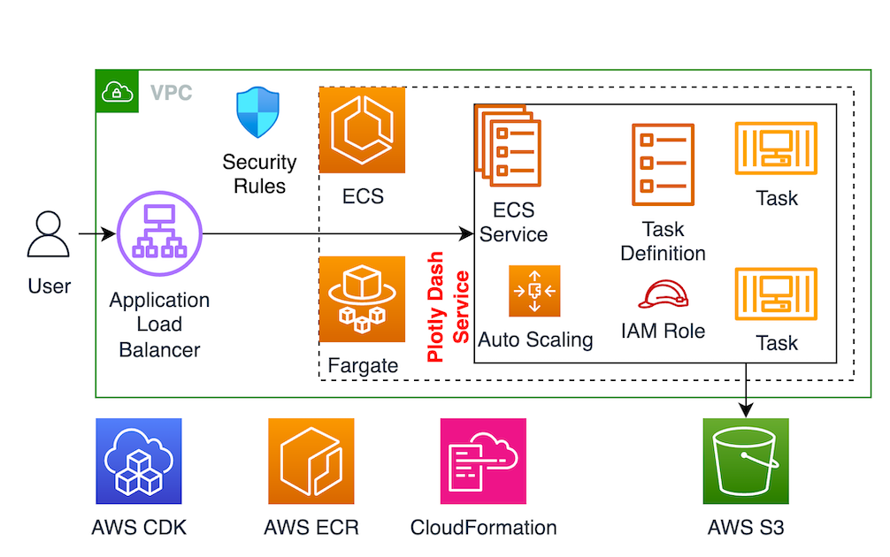
Amazon DASH
How to host a Plotly Dash app on AWS ECS
The product categories with Amazon buttons are divided into the following:
Food and beverage
Baby and children
Beauty
Home
Health and personal care
Sumber:
https://builder.aws.com/content/2b5BdBSPekJdZjRjwwhYcCl7psF/how-to-host-a-plotly-dash-app-on-aws-ecs
https://www.oleoshop.com/en/blog/amazon-dash-buttons-home-automation-in-supplying

Slide 18
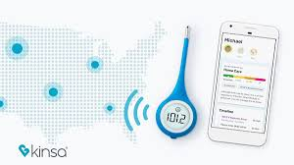
Kinsa thermometer
Monitoring your temperature and can call your doctor as necessary
https://appleinsider.com/articles/23/07/09/kinsa-quickscan-thermometer-review-simple-and-accurate

Slide 19
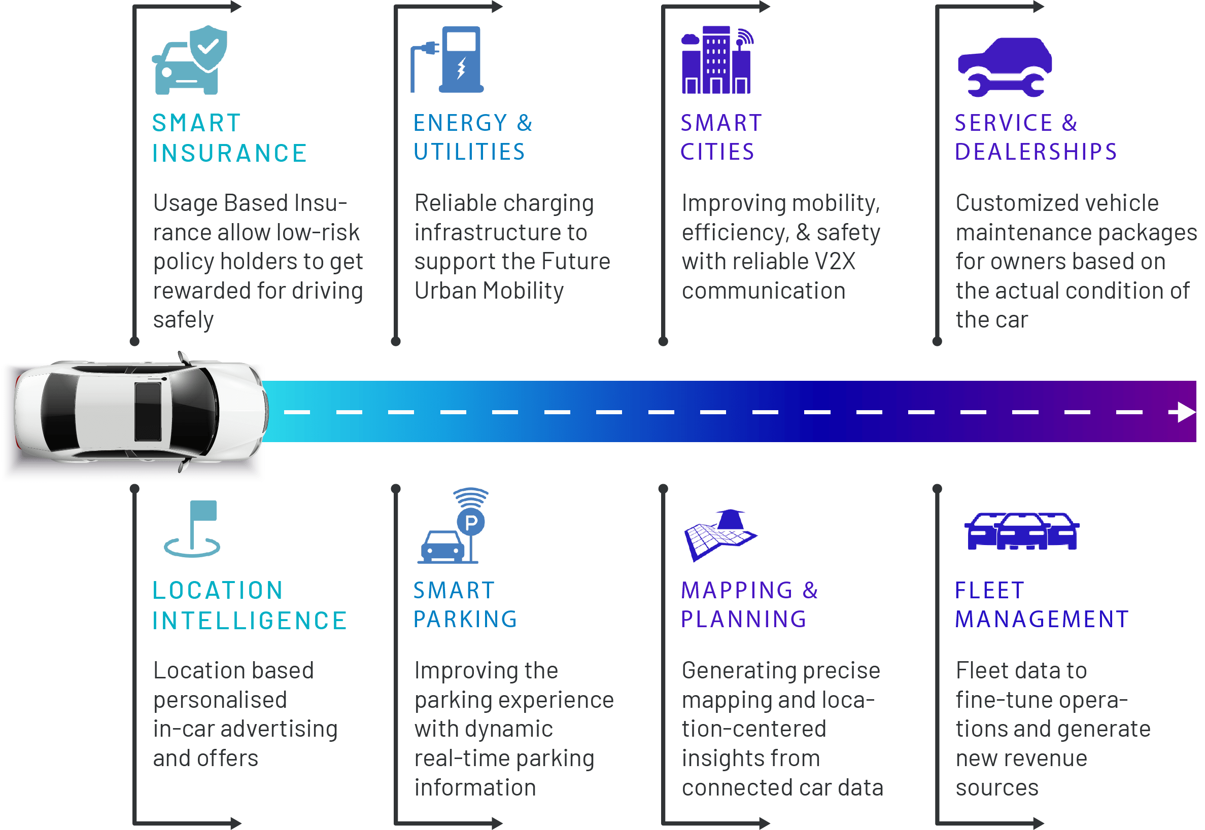
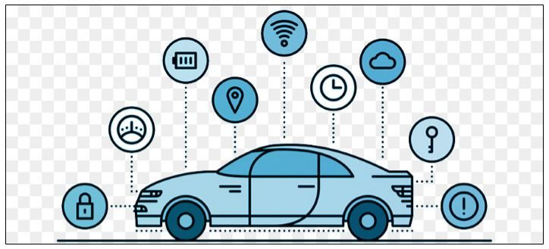
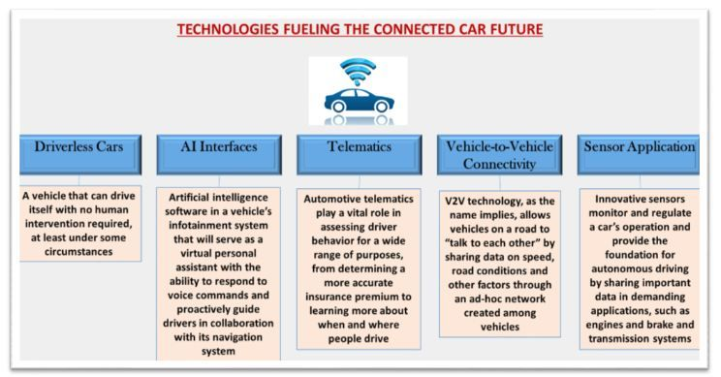
Connected car story
8 Industries Being Transformed by Connected Car Data
Source: https://www.airlinq.com/8-industries-being-transformed-by-connected-car-data/

Slide 20
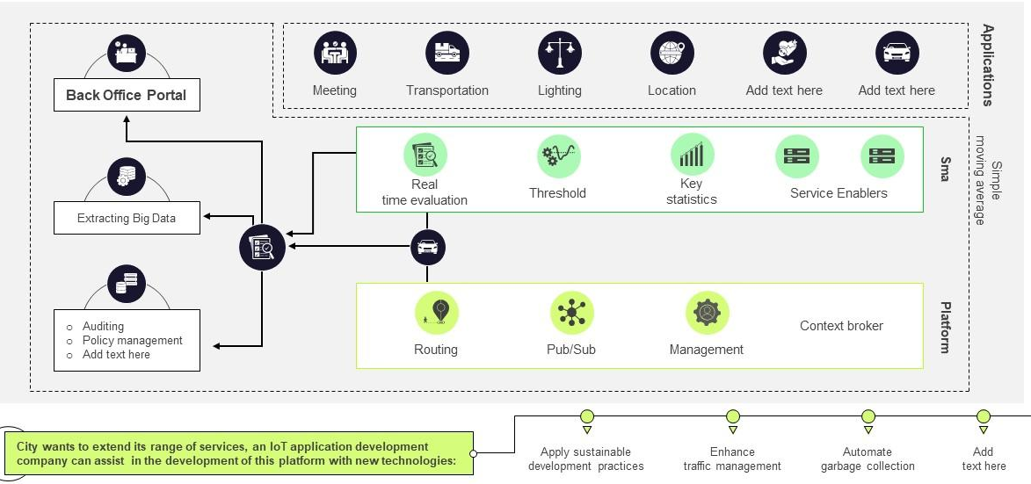
Smart cities Implementation Model

Slide 21
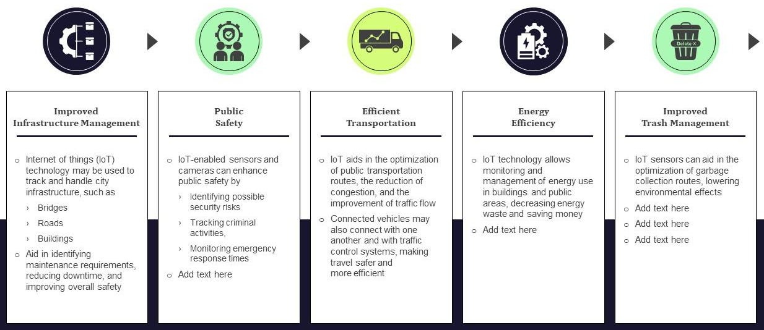
Smart cities to enhance overall architecture

Slide 22
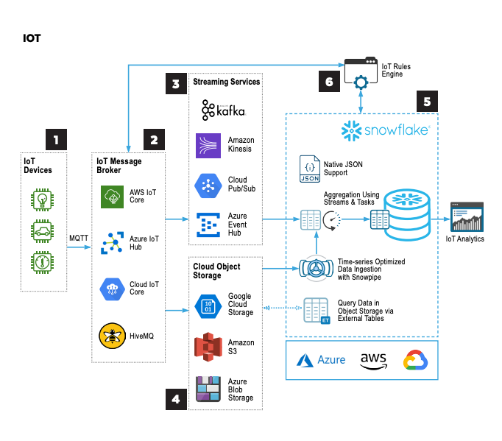
Smart Data Warehousing

Slide 23
Smart farming: Use of iot to improve agriculture
In IoT-based smart farming, a system is built for monitoring the crop field with the help of sensors (light, humidity, temperature, soil moisture, etc.) and automating the irrigation system. The farmers can monitor the field conditions from anywhere. This is highly efficient compared to the traditional/conventional approach.
In terms of environmental issues, IoT-based smart farming provides great benefits including: better and efficient water usage, and optimization of inputs and treatments.
Therefore, smart farming based on IoT technologies enables growers and farmers to reduce waste and enhance productivity.
Some of the IoT applications in this area are:
Precision farming
Agricultural drones
Livestock monitoring
Smart greenhouses

Slide 24
Industrial Iot (iiot)
Industrial IoT (IIoT) focusses on the use of cyber-physical systems to monitor the physical factory processes and make data-based automated decisions.
While the physical systems are made the intelligent using IoT, the real-time communication, and cooperation both with each other and with humans is established via the wireless web
IIoT brings in the concept of ‘a connected factory leads to a smart factory’.

Slide 25
Iiot in manufacturing
Digital/connected factory: IoT enabled machinery can transmit operational information to the partners like original equipment manufacturers and to field engineers.
Facility management: The use of IoT sensors in manufacturing equipment enables condition-based maintenance alerts.
Production flow monitoring: IoT in manufacturing can enable the monitoring of production lines starting from the refining process down to the packaging of final products.
Inventory management: IoT applications permit the monitoring of events across a supply chain.

Slide 26
Iiot in manufacturing (cont’d)
Plant Safety and Security: IoT combined big data analysis can improve the overall workers’ safety and security in the plant. .
Quality control: IoT sensors collect aggregate product data and other third-party syndicated data from various stages of a product cycle.
Packaging Optimization: By using IoT sensors in products and/or packaging, manufacturers can gain insights into the usage patterns and handling of product from multiple customers.
Logistics and Supply Chain Optimization: The Industrial IoT (IIoT) can provide access to real-time supply chain information by tracking materials, equipment, and products as they move through the supply chain.

Slide 27
IOT CHALLENGES
Security, privacy and data sharing issues
Because IoT devices are closely connected, all a hacker has to do is exploit one vulnerability to manipulate all the data, rendering it unusable. And manufacturers that don't update their devices regularly -- or at all -- leave them vulnerable to cybercriminals.
However, hackers aren't the only threat to the internet of things; privacy is another major concern for IoT users. For instance, companies that make and distribute consumer IoT devices could use those devices to obtain and sell users' personal data.
Challenges with IIoT:
Security of data – same as above
Reliability and stability – of IIoT sensors
Connectivity of all the systems in IIoT setup – no maintenance envisioned?
Blending legacy systems – IIoT is new in the market

Slide 28
What NEEDS TO be done?
Consumer education
Product reviews and comparisons
Vulnerability disclosure and vulnerability markets
Self-certification and voluntary codes of practice
Trust marks and labels like Internet Society’s Online Trust Alliance (OTA) IoT Trust Framework
Government initiatives
Mandated security requirements
Mandated certification
Liability reform
Etc.
No intervention!?

Slide 29
The future of iot
Bain & Company expects annual IoT revenue of hardware and software to exceed $450 billion by 2020.
McKinsey & Company estimates IoT will have an $11.1 trillion impact by 2025.
IHS Markit believes the number of connected IoT devices will increase 12% annually to reach 125 billion in 2030.
Gartner assesses that 20.8 billion connected things will be in use by 2020, with total spend on IoT devices and services to reach $3.7 trillion in 2021.
By 2023, the average CIO will be responsible for more than three times as many endpoints as this year – Gartner
Garter forecasts that worldwide IoT Security Spending will be 3.11 billion by 2021 largely driven by regulatory compliance.
Great improvements in the security of IoT devices driven by manufacturers’ own initiatives as well users’ demand for better secure devices.
Global manufacturers will use analytics data recorded from connected devices to analyze processes and identify optimization possibilities, according to IDC and SAP.
Business Insider forecasts that by 2020, 75 percent of new cars will come with built-in IoT connectivity.

Slide 30
References
“Internet of Things Research Study”, http://www8.hp.com/us/en/hp-news/press-release.html?id=1909050 [Hewlett Packard (2015)]
https://security.radware.com/ddos-threats-attacks/threat-advisories-attack-reports/iot-devices-threat-spreading/
https://www2.deloitte.com/ng/en/pages/technology-media-and-telecommunications/articles/global-mobile-consumer-survey.html
https://www.newgenapps.com/blog/8-uses-applications-and-benefits-of-industrial-iot-in-manufacturing
https://cdn2.hubspot.net/hubfs/202339/Industry%2040%20eBook.pdf
https://www.iotforall.com/iot-applications-in-agriculture/
https://internetofthingsagenda.techtarget.com
https://www.forbes.com/sites/jacobmorgan/2014/05/13/simple-explanation-internet-things-that-anyone-can-understand/#ef2433f1d091
https://www.gartner.com/en/newsroom/press-releases/2018-11-07-gartner-identifies-top-10-strategic-iot-technologies-and-trends
https://www.gartner.com/en/newsroom/press-releases/2018-03-21-gartner-says-worldwide-iot-security-spending-will-reach-1-point-5-billion-in-2018
https://www.makeuseof.com/tag/internet-things-10-useful-products-must-try-2016/

Slide 31
Thank you!
PDS
Computer Vision
Q&A
Thank you For being a great class!
https://github.com/siagianp
https://www.youtube.com/@AmelOline/videos
https://github.com/amelcharolinesgn2/IoT_simulator-mqtt-NodeRed
https://github.com/amelcharolinesgn2/Cloud-Infrastructures
https://github.com/amelcharolinesgn2/ClouD-Infrastructure-SISKA-2025
Notes:
https://medium.com/buildpiper/simplifying-containerization-with-docker-run-command-2f74e114f42a
https://github.com/IBA-Group-IT/IoT-data-simulator
https://www.bevywise.com/blog/docker-mqtt-broker-easy-service-manageability/

